Slide 1
DATA ANALYTICS APPROACH TO SEGEMENT CUSTOMER BASED ON THEIR INTERESTS

Slide 2
AGENDA
Problem Definition
Proposed Solution
Data collection
Data Cleaning
RFM score calculation

Slide 3
PROBLEM DEFINITION
Customers are of different character and have different needs.
By following different strategies to attract different customers according to their interests or needs a company can earn more profit.
For applying different strategies here is the approach to segment the customers based on their interests.
Customer segmentation helps a company to identify the difference between the customers.
It will be easier to meet their customer needs and take care of customers who are of high importance for their company.

Slide 4
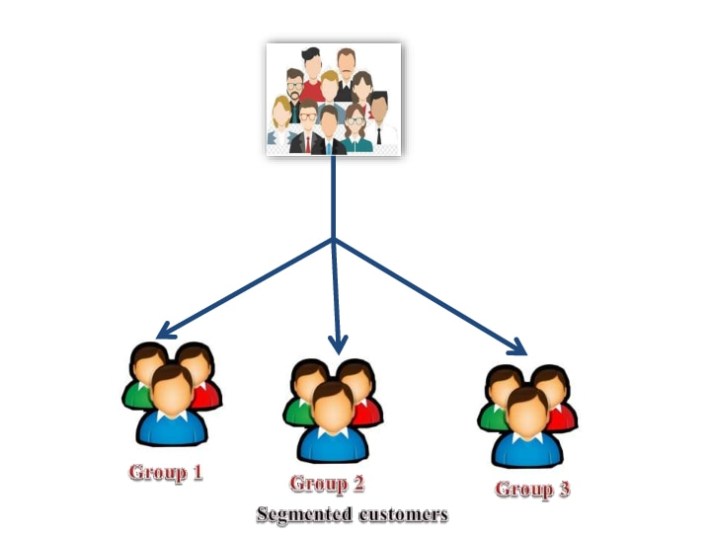
PROBLEM DEFINITION(CONTD…)

Slide 5
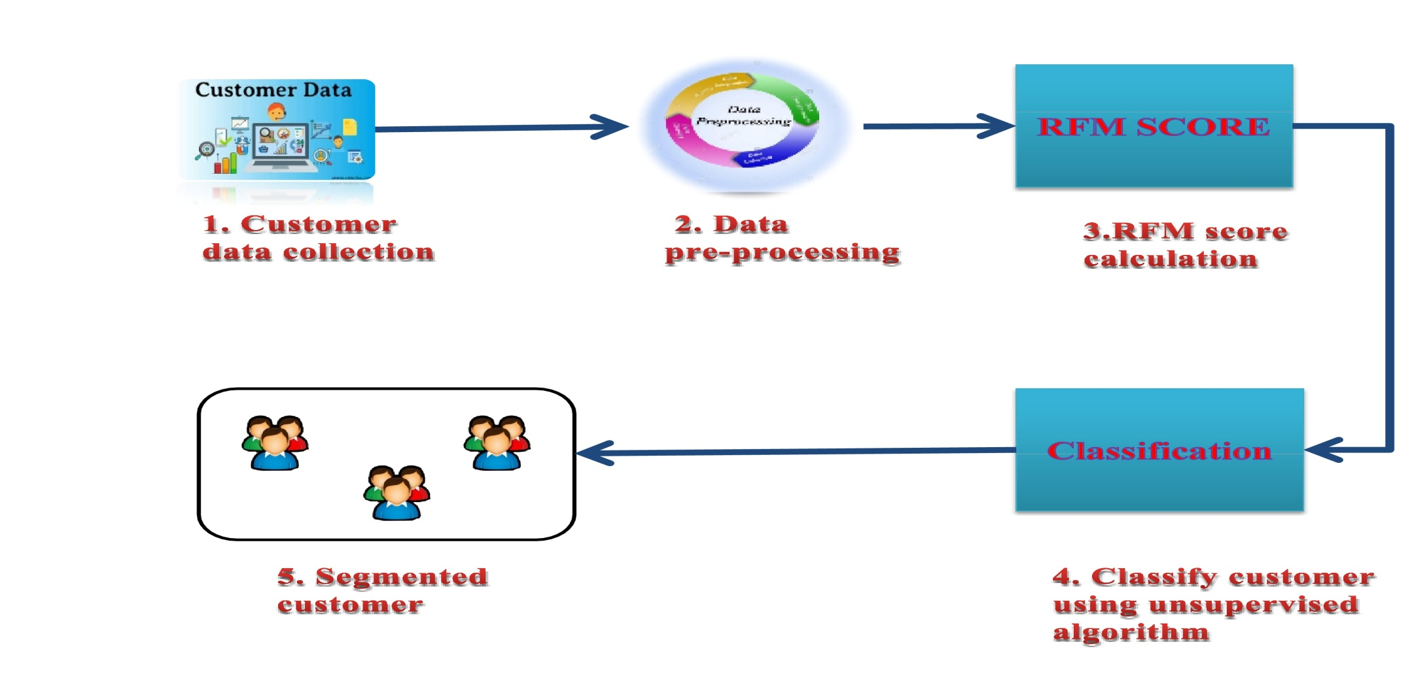
PROPOSED SOLUTION

Slide 6
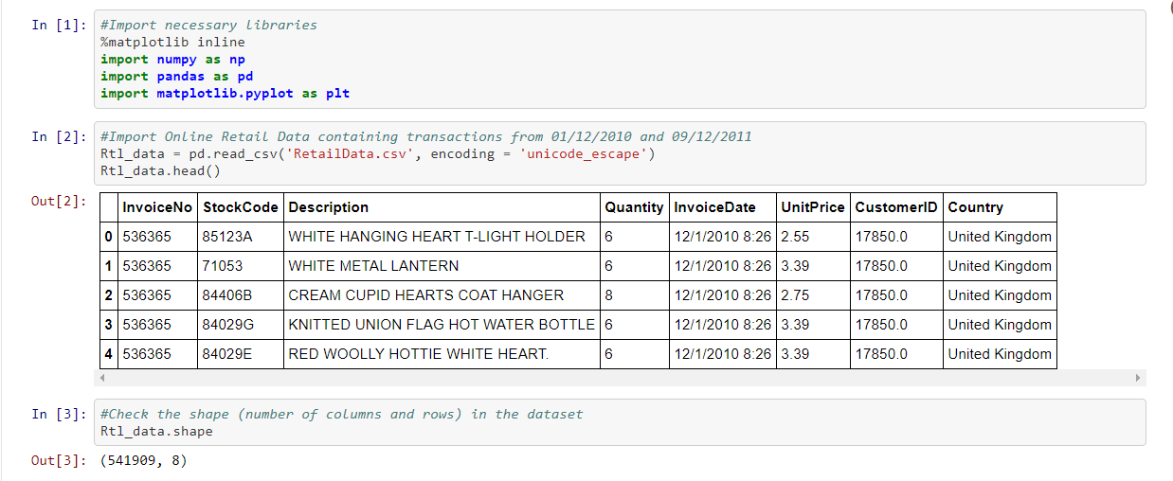
INFORMATION ABOUT THE DATA:

Slide 7
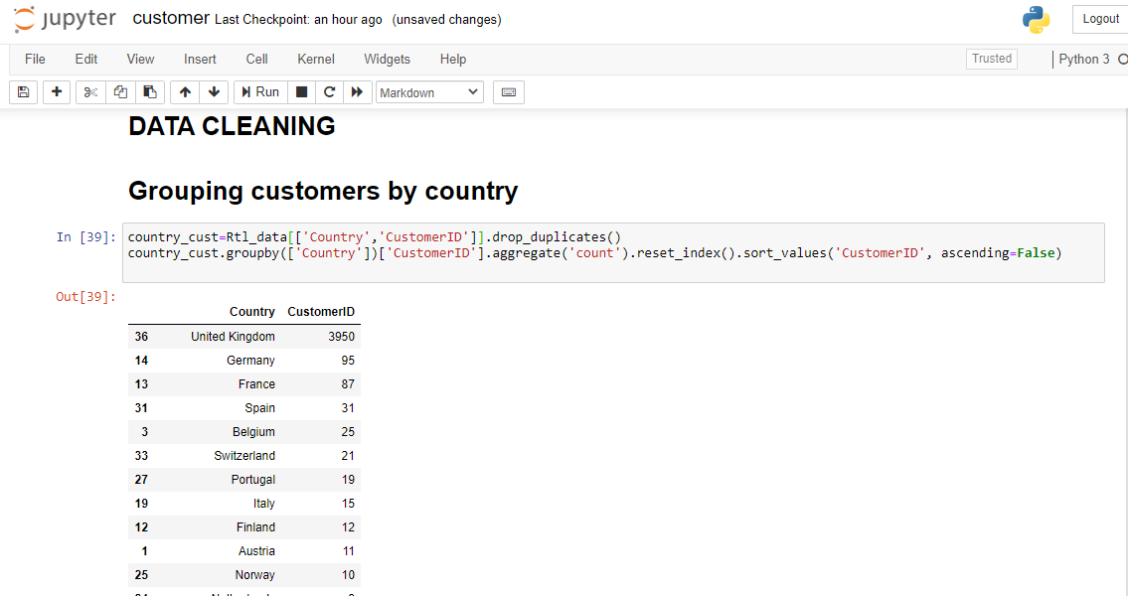
DATA CLEANING

Slide 8
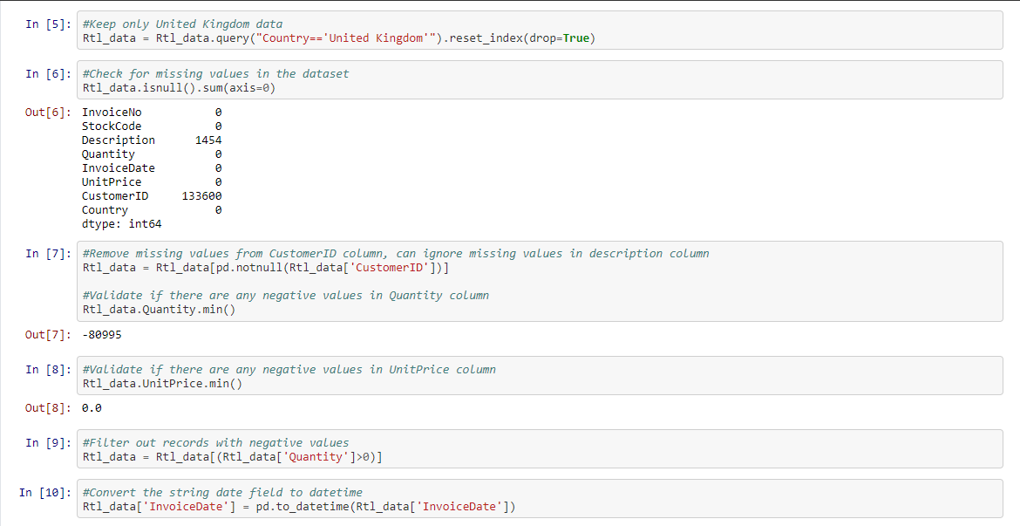
DATA CLEANING (CONTD..)

Slide 9
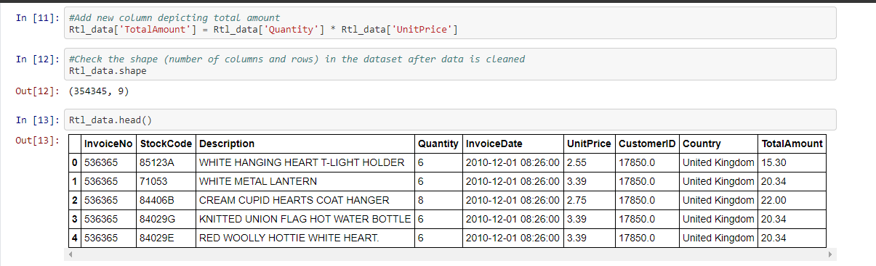

Slide 10
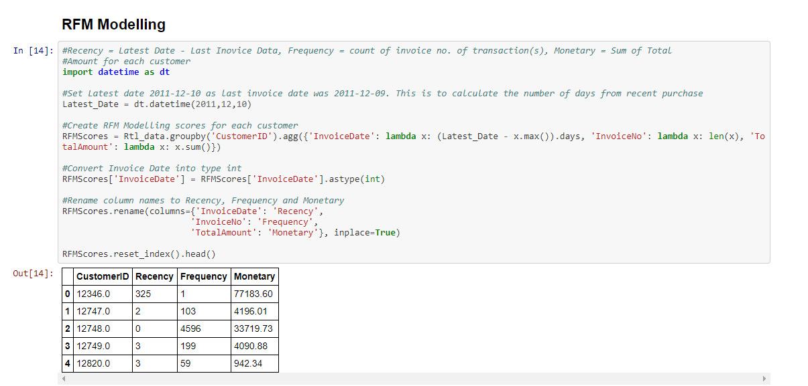
RFM SCORE CALCULATION

Slide 11
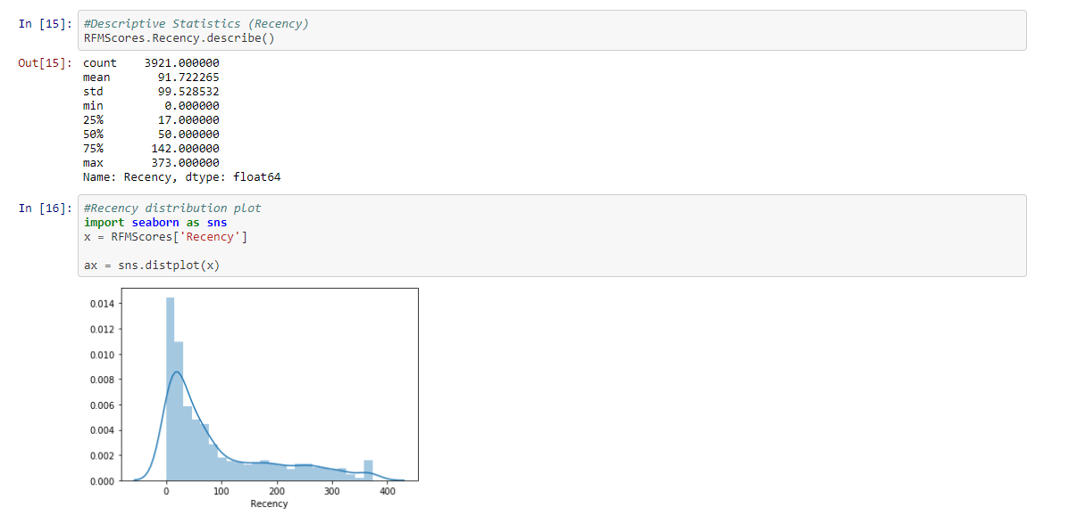
DESCRIPTIVE STATISTICS FOR RECENCY

Slide 12
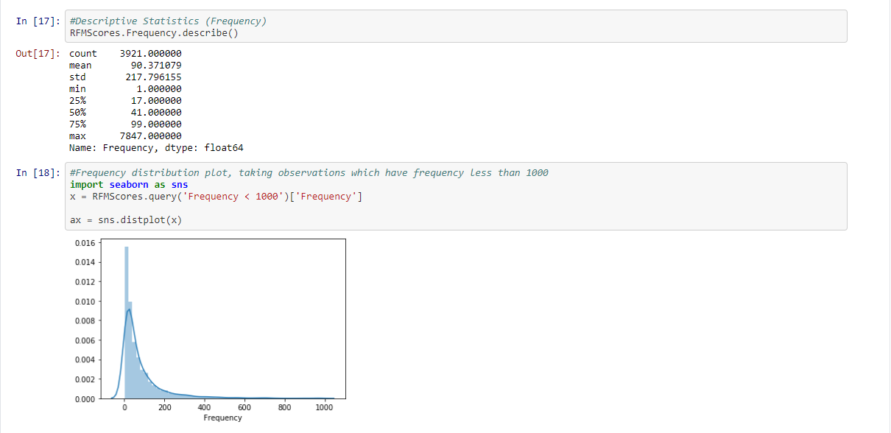
DESCRIPTIVE STATISTICS FOR FREQUENCY

Slide 13
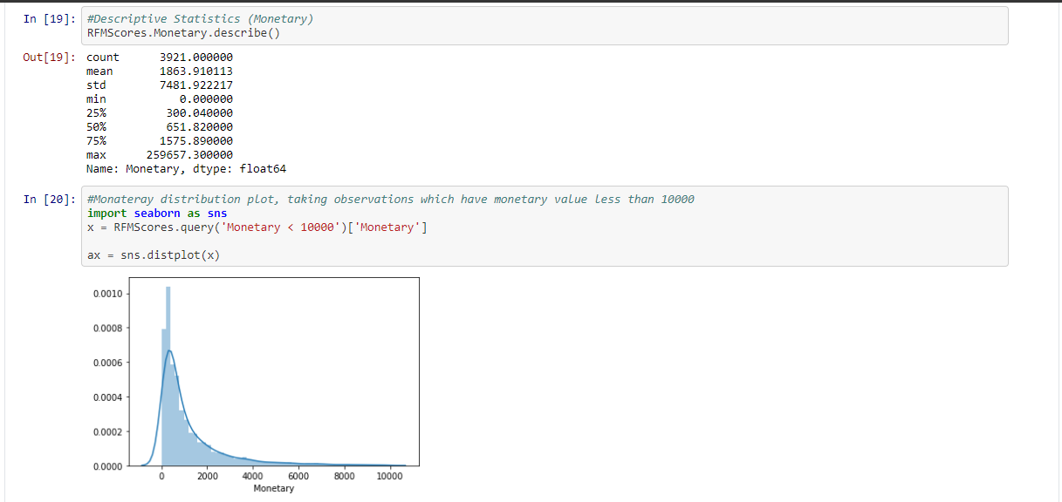
DESCRIPTIVE STATISTICS FOR MONETARY

Slide 14
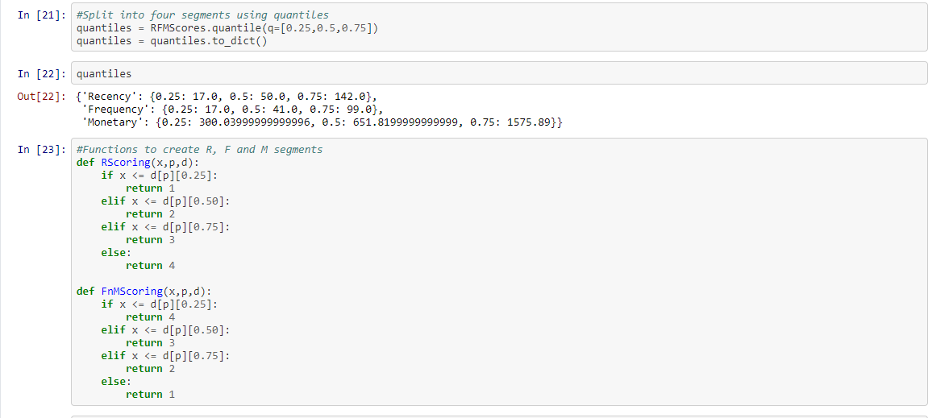

Slide 15
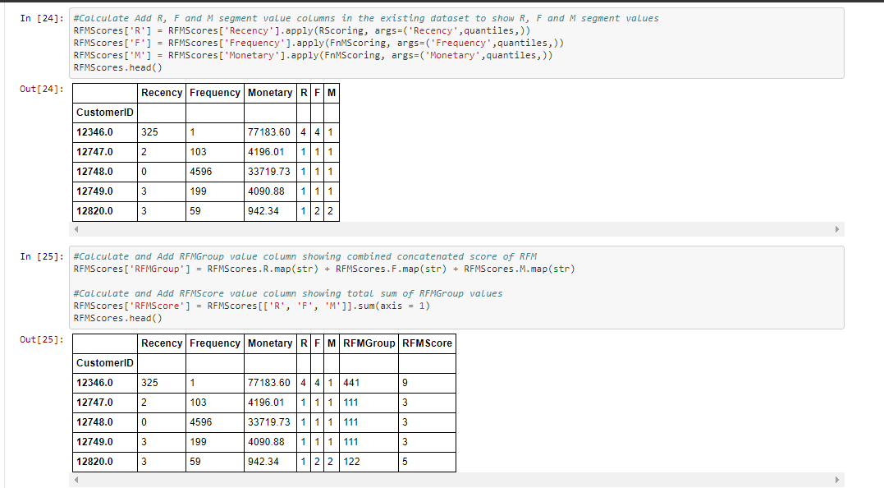

Slide 16
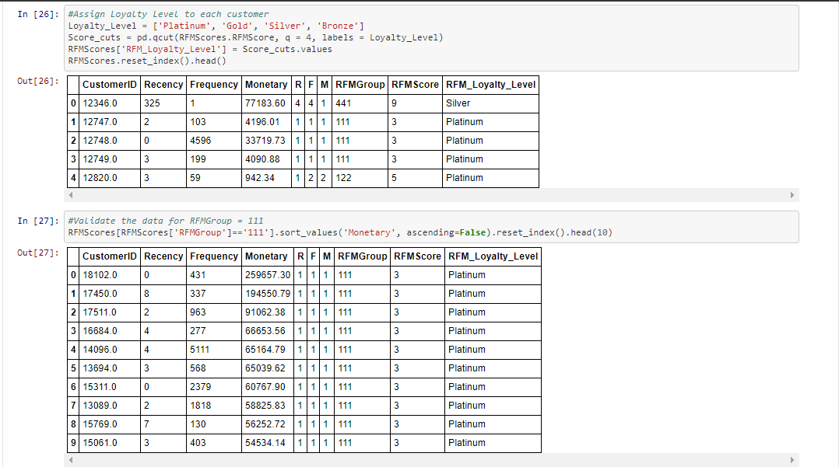
RFM SCORE FOR LOYAL CUSTOMERS

